Slide 1
Quadruped Robot for Agricultural Research
Team: Austin Neff, Kevin Nelson, Jordan Raver, Ben Seisser, Sam Spencer, Yang Yang
Team Advisors: Shad Roundy, Kam Leang

Slide 2
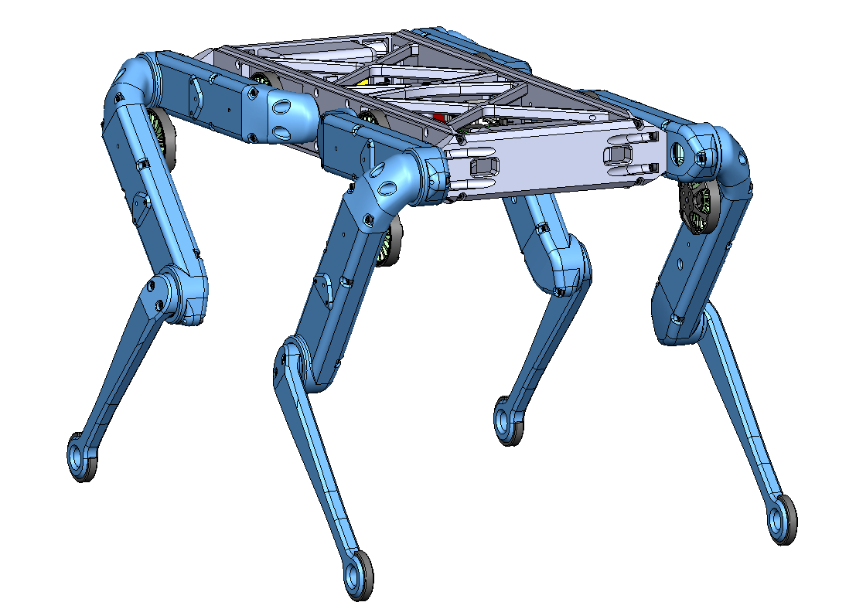
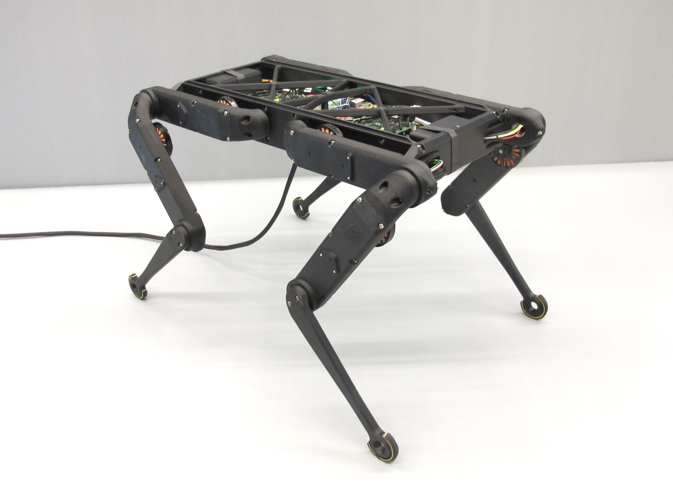
Project Objective
The objective of the project is to construct a quadruped robot. The Open Dynamic Robot Initiative will be followed closely. The robot is intended as a cheaper alternative for robot smart agriculture than what is currently available in professors Roundy and Leang’s laboratories.

Slide 3
Scope
Must be part of scope | Optional next steps (rank) | Not included in Scope
Runs on ROS 2 Use ROS 2 Humble (convert original code from Foxy) Autonomous; no tether (First prototype on tether) On-board Power System that can run for 1-2 hours Can navigate to four points in a field. Modify design to enclose electronics. Easily storable, carryable (handles, box) Utah red colors | Fully assembled by end of first semester (Fiberglass infused ABS) Rebuild chassis with stronger materials during second semester (machined aluminum) | Additional actuators Additional sensors Efficient walking Large Deviations from Open Dynamic Robot Initiative Manipulators Radio beacon triangulation 12 degree of freedom

Slide 4
Existing Designs
Existing Design | Description | Why it doesn’t meet scope
Boston Dynamics Spot | High End Industrial Quadruped | Too expensive
Unitree Go2 Air | Affordable recreational high capability quadruped. | Locked down software (unsuitable for research)
DJI Mavic 3 | Aerial drone designed for agricultural use | Unable to do direct ground testing (aerial), limited battery life
ANYbotics ANYmal | High end industrial quadruped | Too expensive, limited battery life
Dingo Quadruped | Small, cheap quadruped than can be built at home using github repository and 3D printer. | Doesn’t meet our base requirements (ROS2)

Slide 5
Design Metrics
Metric # | Customer Needs # | Metric | Units
1 | 6 | Cost of the robot | <$10,000
2 | 1 | Robustness and strength of the robot chassis materials (load) | 1.5 times total weight (lbs)
3 | 5 | Robot runtime while all motors are moving | 1-2 hrs
4 | 2 | Response Time | 1-10 ms
5 | 8 | Wireless Delivery | 500-1000 Hz
6 | 7 | Option to add modularity to the robot | 2 #nodes
7 | 1 | Accuracy of inertial measurement | 0.1 mgs
8 | 8 | Radio receiver range | >1000 ft
Notes:
Include your metrics table from Assignment 02 once complete in 1 slide.
Include a column for items that are in scope, stretch goals, and tasks out of scope.
Each design review, you should highlight any changes to the metrics that have occurred since your last meeting.
Touch on any metrics that your design has met or are in process since your last design review.

Slide 6
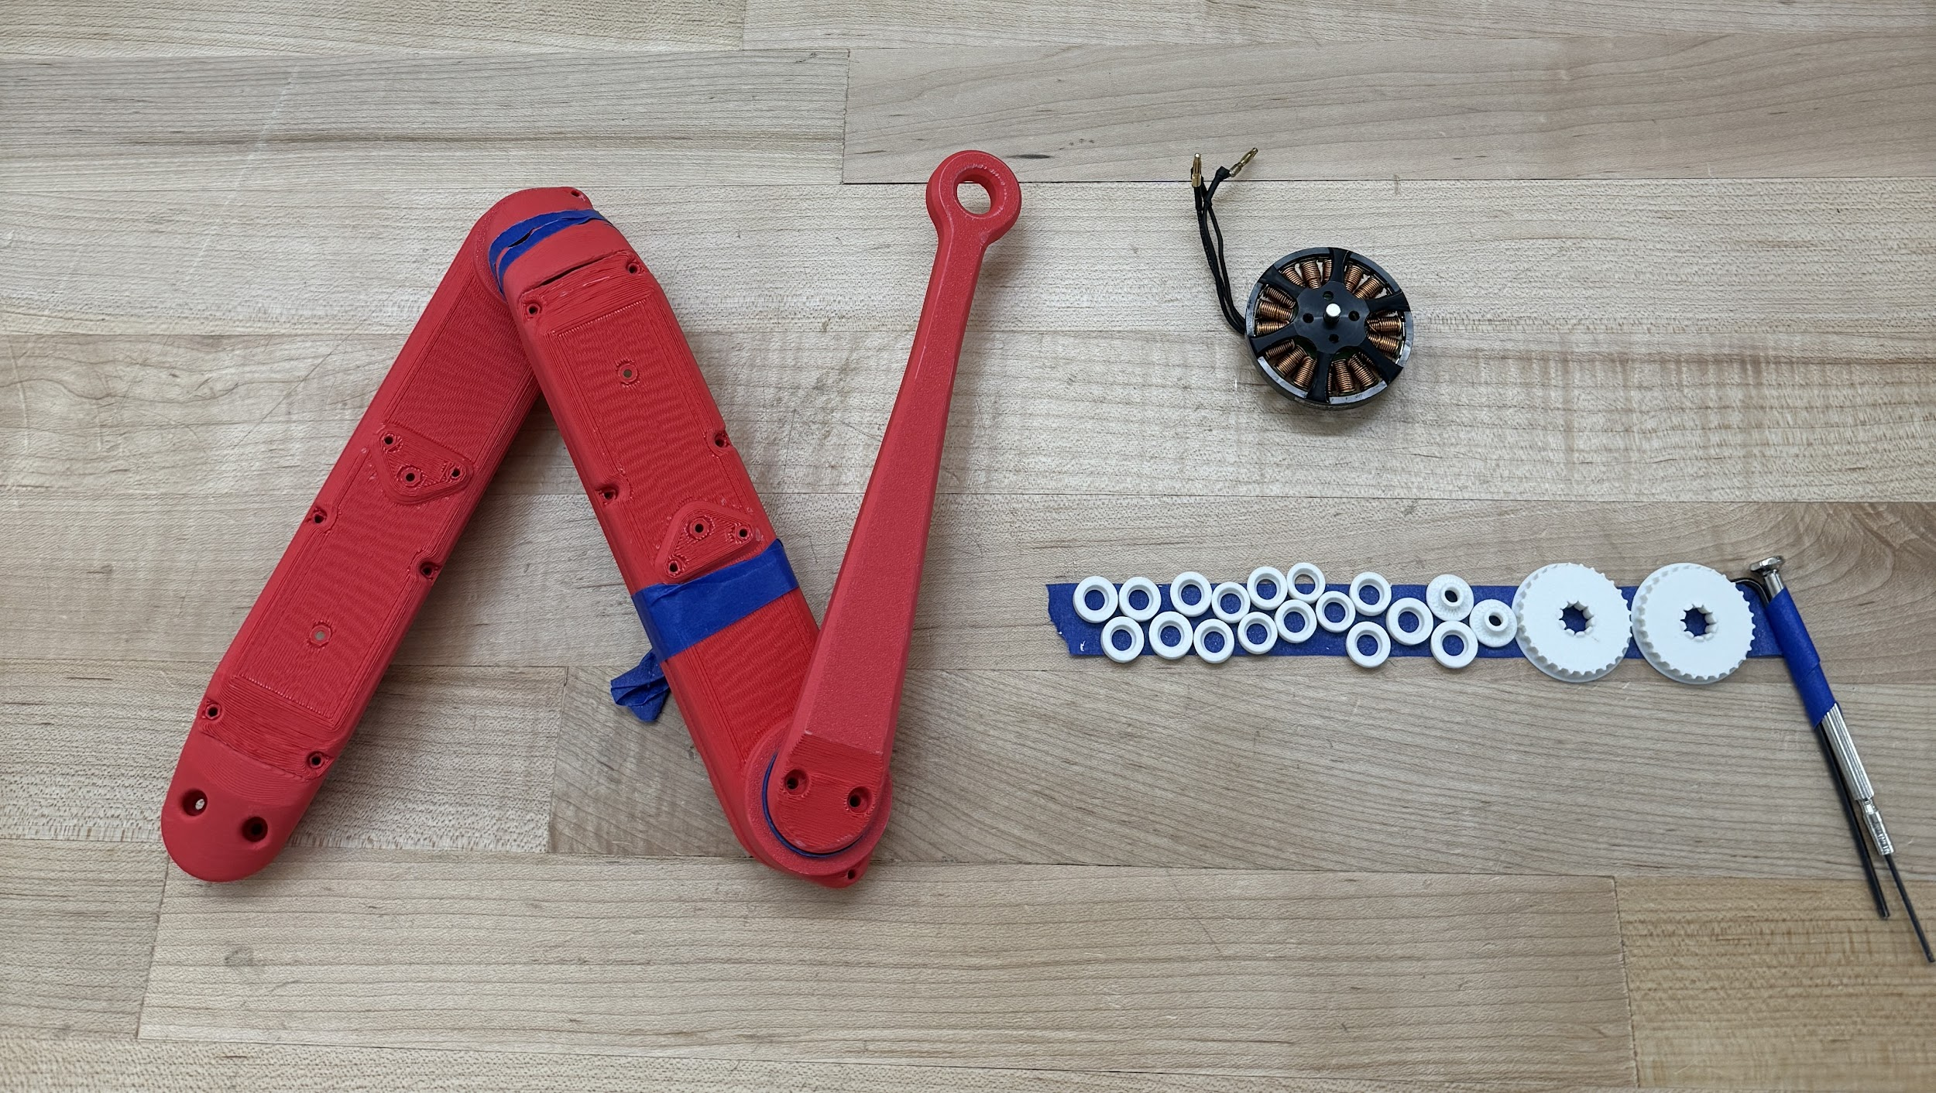
Progress: Body Creation
Brushless motors acquisition from Dr. Leang’s Lab
Leg segments have been printed from PLA including internal pulleys
Test prints using CF PLA have also been done using Dr. Leang’s printer.
Notes:
Progress since the last presentation
3-4 slides
Discuss recent progress, especially in the context of the Design Process that we are following
Specific quantitative results are best if available
Early on, you may just be getting things started and that’s OK. In those cases, you will discuss your thoughts and ideas and plans going forward more than results and progress.

Slide 7
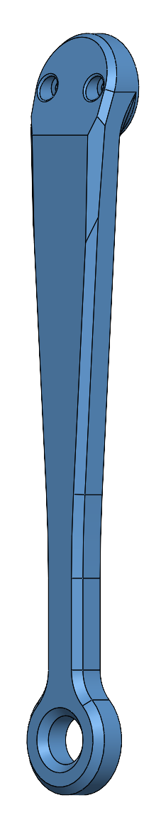
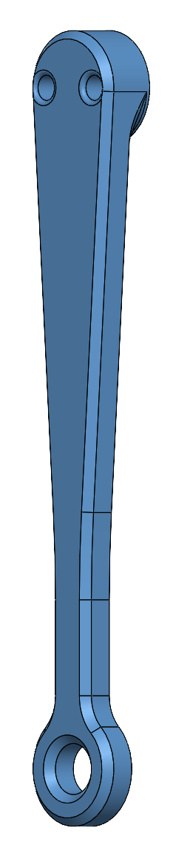
Progress: Lower Leg Simplicity Redesign
Original Left
Modified Right
Notes:
Main and only difference between the two legs is the fact that the modified leg gets rid of the slope that is next to the joint. This will allow the print to look smoother and won’t have any weird blobs form from the weird angle.

Slide 8
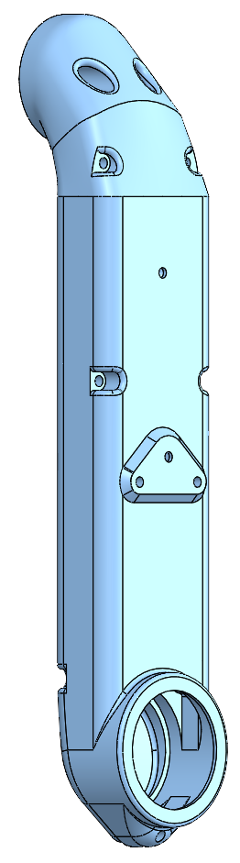
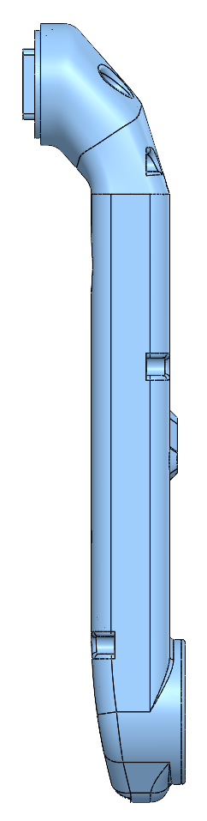
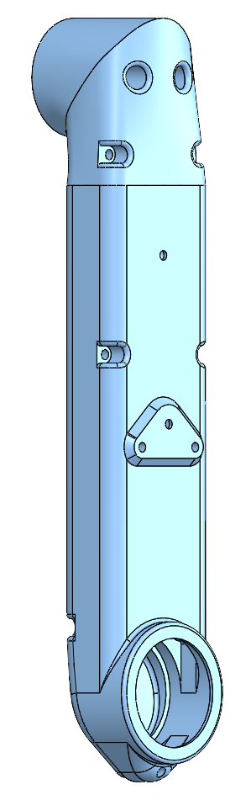
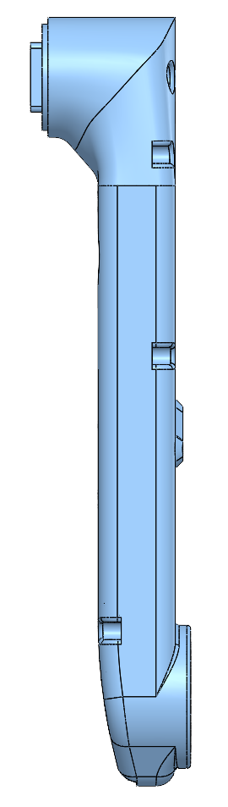
Progress: Main Leg Simplicity Redesign
Original Left
Modified Right
Notes:
Original is on the left and the new modified leg is on the right.
Following same trend as the modified lower leg.

Slide 9
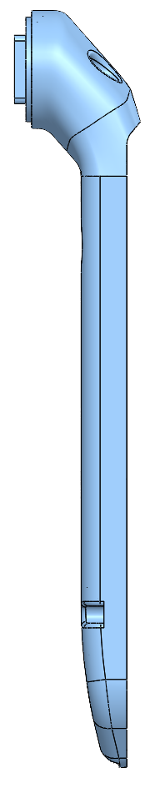
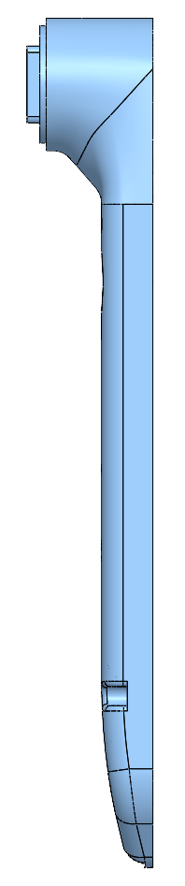
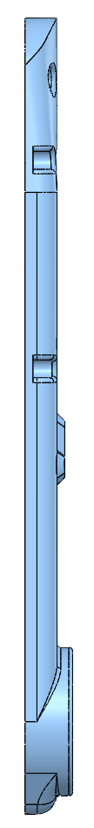
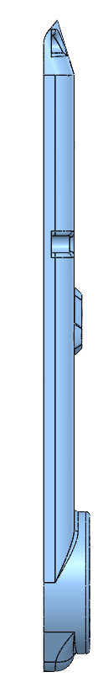
Progress: Main Leg Simplicity Redesign
Original Left
Modified Right
Notes:
Main problem that we faced when printing the main leg shell and cover was how the original creators recommended to print it. This led to a lot of support use and wasted material.
Modified design allows us to flip the leg 180 degrees and print a very smooth surface between the shell and cover.
Another plus from the changing in printing orientation and shape is getting rid of the slope between the cover and shell. This slope would have random blobs form. Resulting in more time being needed for assembling the leg. Needed to sand this area down by hand. This would often leave gaps between the shell and cover.

Slide 10

Progress: ROS2 “Humble Hawksbill”
ROS2 is a software library used to make complex robot platforms
Existing ROS2 code sourced from open-source project
Ported from ROS2 Foxy
Successfully compiled on x86
The system we want to run the robot on is ARM, which will likely involve some extra work
Future code iterations will begin on existing code

Slide 11
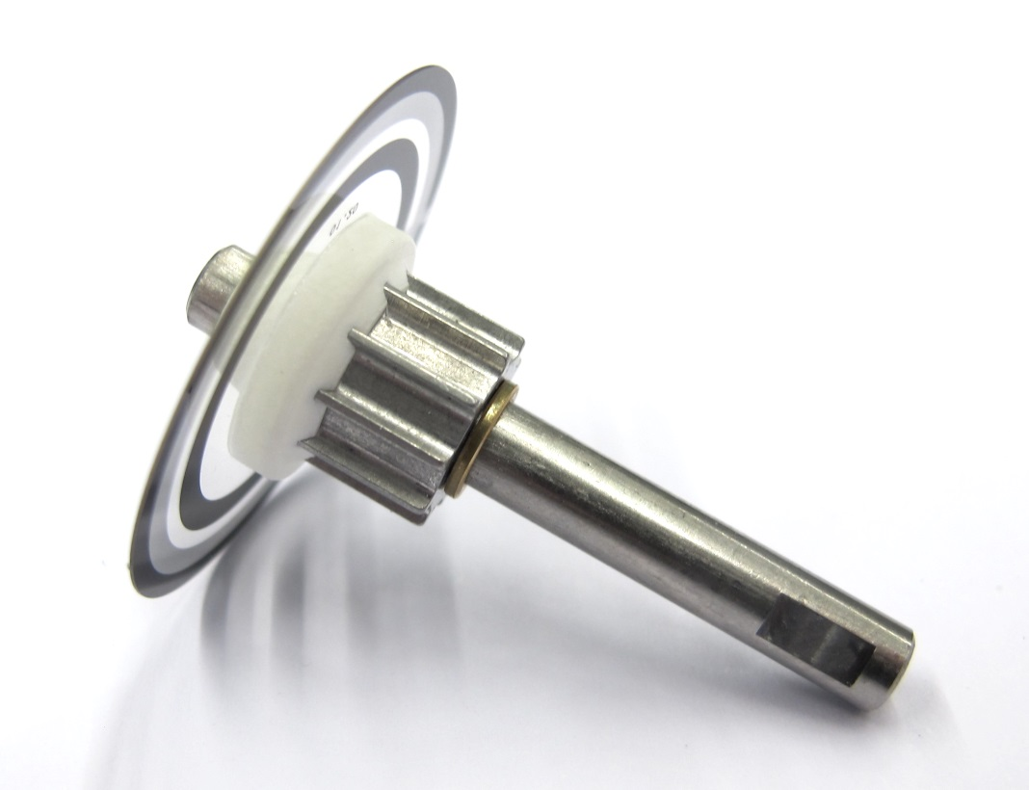
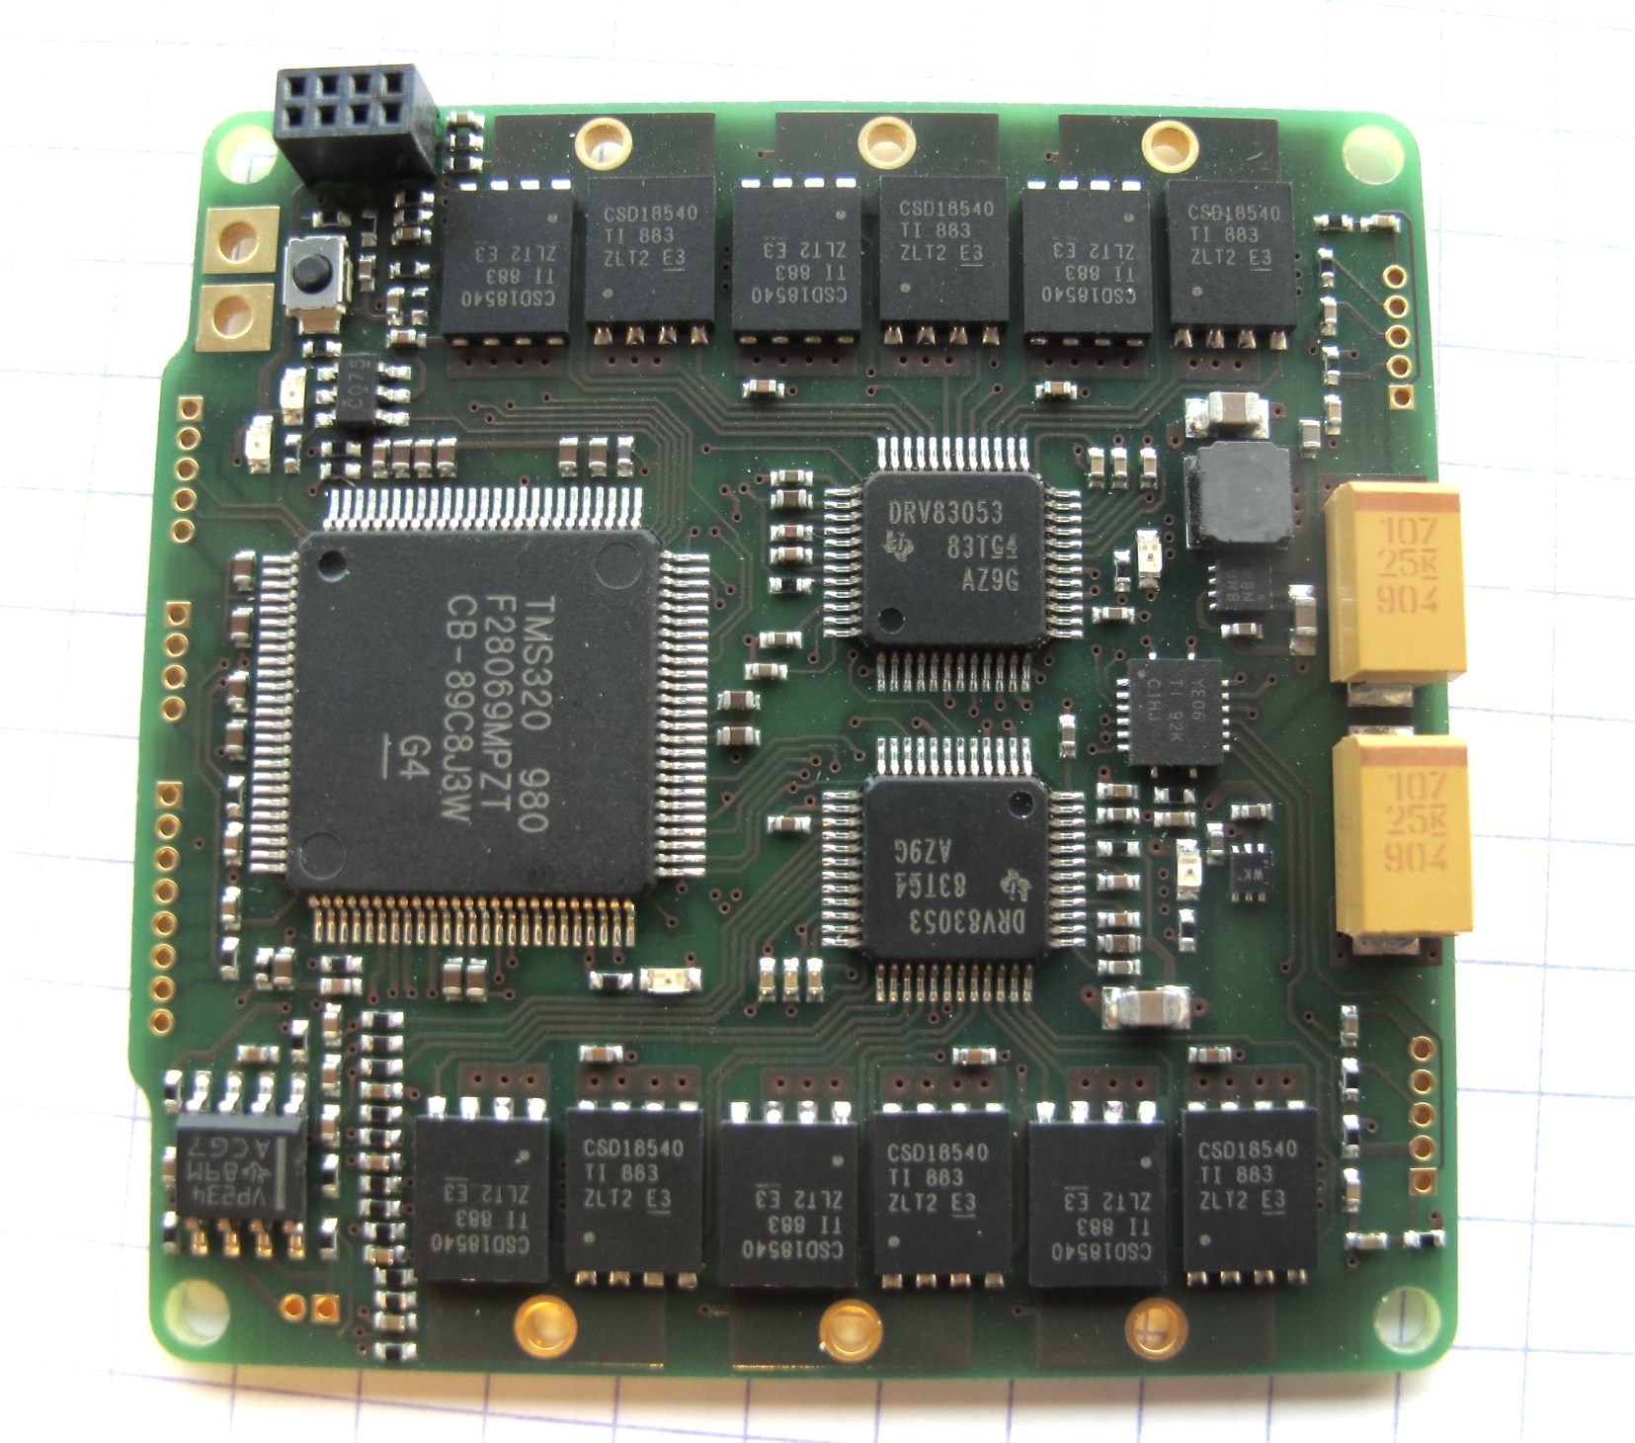
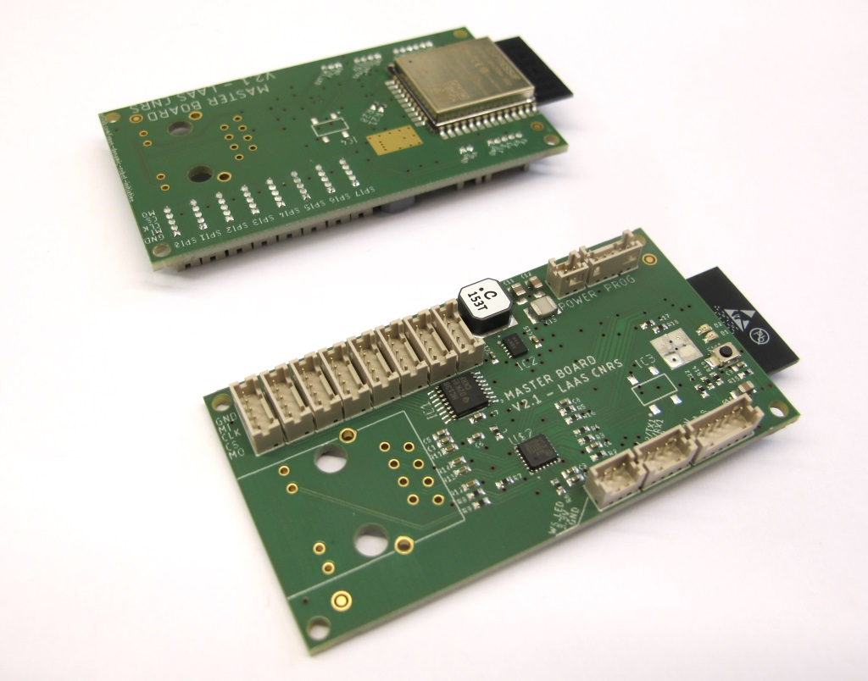
Progress: Part Acquisition
Generic parts ready for order
Custom parts in order pipeline
Encoder Wheels: Quote Received
Motor Driver: Quote Requested
Master Board: Quote Requested
a)
b)
c)
Figure: a) Encoder wheel kits, b) Motor Driver board, c) Master board

Slide 12
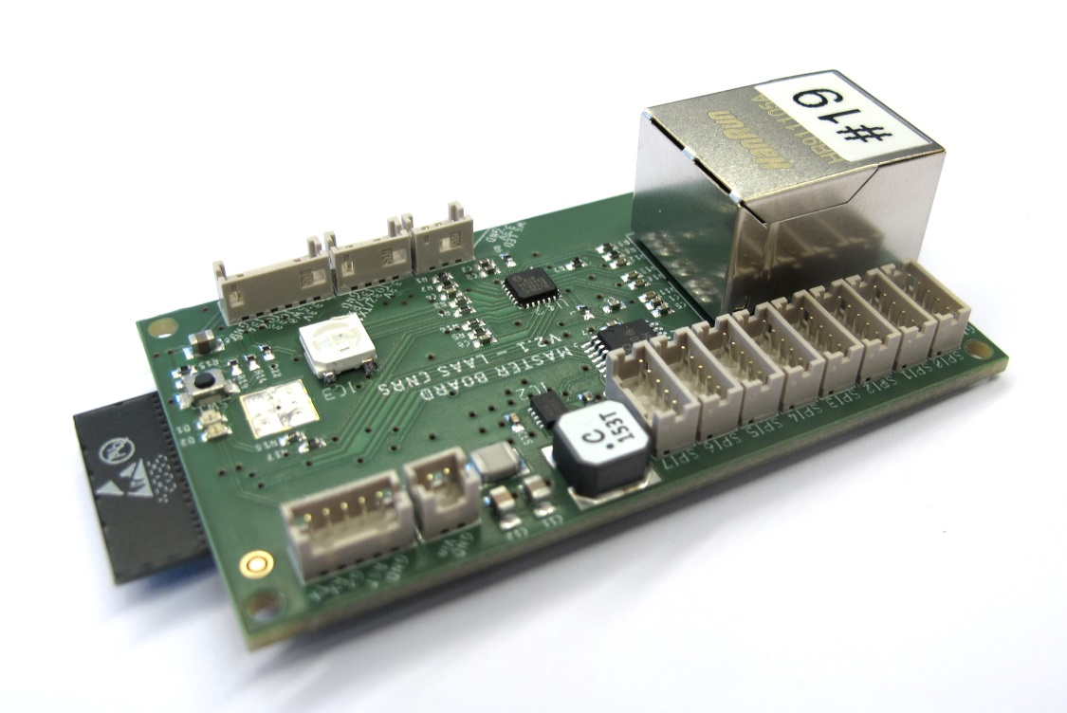
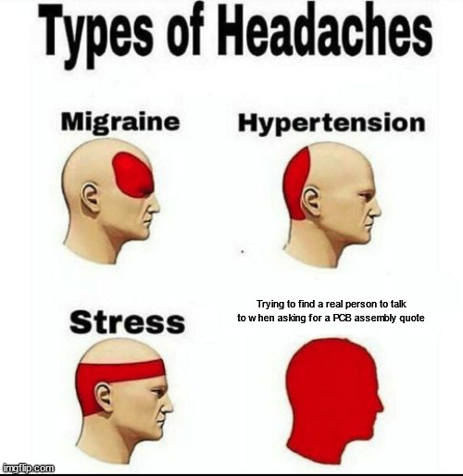
Issues: Part Acquisition
Issues with coordinating with suppliers to get a quote for an assembled PCB
Lead times
Encoder Kits: 4-6 Weeks
Misc. Parts: ~1 Week
Solution: check local suppliers recommended by our advisors for quotes
Notes:
Technical Difficulty/Questions/Issues
1-2 slides as needed
Any specific technical challenges or questions that you would like to share with the teaching team
Only present this information if needed. If you have nothing to present under this topic, that is fine.

Slide 13
Plans
Timeline:
Before Encoder Delivery (<4-6 Weeks, Concurrent)
Get quotes for PCB Assembly and place order (Week 1)
Design/alter body to fit new design specifications (Week 1)
Complete ordering forms for off-the-shelf parts (Week 2)
Finish printing the parts (Week 2)
Assemble chassis and pre-assemble legs (Week 3)
After Encoder Delivery (Assuming delivery on Week 4)
Week 5: Assemble robot legs and work on attaching leg electronics to drivers and master board
Week 6: Finish electronics and work on robot controls with tether
Week 7: Robot controls and fixing any issues with the chassis
Notes:
Plans
1-2 slides
Detailed plans for the next 3-4 weeks
Include schedule once it has been developed for the course
Discuss budget and spend once purchasing begins

Slide 14
Plans
Budget:
Total Budget: $6000 Robot + $1000 Power System
Goal is to stay as far under this as possible
Current Estimate: ~$4344.31/$6000
8 Encoder Kits: $1,245.77
Boards: ~$400
Inertial Measurement Unit: $1,361.44
Alternative is being looked for (new estimate: ~$7 and extra software work)
Off-the-Shelf (OTS) Leg Components: $1,102.61
Electrical Parts: $160.42
Less if found in the lab
Fasteners: $74.07
Less if found in the lab

